Slide 1
INDIA AIR QUALITY INDEX
CSE3020
DATA VISUALIZATION
REVIEW 2
MENTOR DETAILS:
Dr. Joshan Athanesious J
School of Computer Science and Engineering
Vellore Institute of Technology (VIT), Chennai
TEAM MEMBERS:
Sanjil K C – 20BCE1855
Mahir – 20BCE1524

Slide 2
ABSTRACT
Examining and protecting air quality has become one of the most essential activities for the government in many industrial and urban areas today. The meteorological and traffic factors, burning of fossil fuels, and industrial parameters play significant roles in air pollution.With this increasing air pollution,We Are in need of implementing models which will record information about concentrations of air pollutants(so2,no2,etc).The deposition of this harmful gases in the air is affecting the quality of people’s lives, especially in urban areas. Lately, many researchers began to use Big Data Analytics approach as there are environmental sensing networks and sensor data available.
In this paper, machine learning techniques are used to predict the concentration of so2 in the environment. Sulphur dioxide irritates the skin and mucous membranes of the eyes, nose, throat, and lungs.Models in time series are employed to predict the so2 readings in nearing years or months.

Slide 3
BACKGROUND
In the developing countries like India, the rapid increase in population and economic upswing in cities have lead to environmental problems such as air pollution, water pollution, noise pollution and many more. Air pollution has direct impact on humans health .There has been increased public awareness about the same in our country.Global warming, acid rains, increase in the number of asthma patients are some of the long-term consequences of air pollution. Precise air quality forecasting can reduce the effect of maximal pollution on the humans and biosphere as well. Hence, enhancing air quality forecasting is one of the prime targets for the society. Sulphur Dioxide is a gas.
It is one of the major pollutants present in air.It is colorless and has a nasty, sharp smell.It combines easily with other chemicals to form harmful substances like sulphuric acid, sulfurous acid etc. Sulfur dioxide affects human health when it is breathed in. It irritates the nose, throat, and airways to cause coughing, wheezing, shortness of breath, or a tight feeling around the chest. The concentration of sulphur dioxide in the atmosphere can influence the habitat suitability for plant communities, as well as animal life. The proposed system is capable of predicting concentration of Sulphur Dioxide for forthcoming months / years.

Slide 4
LITERATURE REVIEW
Previous studies show the need to implement efficient air quality monitoring models which collect information about the concentration of air pollutants and provide assessment of air pollution in each area. The aim of this research paper is to investigate various for air quality forecasting.
The nature of air is impacted by multi-faceted elements including area, time, and unsure factors. Past investigates show to think about elements, for example, of air contaminants like NO2,CO, Ground level O3,SO2, PM2.5(particulate matter with diameter of 2.5*(10^-6)m), PM10, and meteorological data like temperature, pressure, humidity, wind speed, wind direction.
Metrics used for evaluating the predictive models were Root Mean Square Error, Normalised Root Mean Square Error, Mean Absolute Error, Symmetric Mean Absolute Percentage Error and Pearson correlation coefficient. The results showed that compared to other methods, SLI-ESN (hybrid Scalable Link Interface-Echo state networks) performed better results

Slide 5
It can be noted that most extensive research has been done in China which is leading this kind of works with 26 papers, followed by nations like Italy, Spain, USA, and more.
we can conclude that
-Rather than utilizing straightforward AI strategies, presently, the authors apply advanced and sophisticated techniques like gradient boost algorithms, random forest, Neural networks, back propagation
-China was the leading main nation as far as such investigations are considered.
-Particulate matter with measurement equivalent to 2.5 micrometers was the fundamental expectation target.

Slide 6
DATA COLLECTION
The data set we used was obtained from Kaggle.
Link – https://www.kaggle.com/datasets/shrutibhargava94/india-air-quality-data
About the Dataset:
Using the above-mentioned dataset, India's air pollution levels can be explored at a more granular scale.
This data is combined (across the years and states) and largely clean version of the Historical Daily Ambient Air Quality Data released by the Ministry of Environment and Forests and Central Pollution Control Board of India under the National Data Sharing and Accessibility Policy (NDSAP).

Slide 7
DATA ANALYSIS APPROACHES
Data Analysis is going to be done using two approaches..
State-wise Data Visualization and Analysis.
Air Quality determinant sample wise Visualization and Analysis.
The State-wise Data Visualization will give results like the maximum polluted state and minimum polluted state, state containing highest concentration of SO2, NO2, etc.
Air Quality Determinant Samples included in the dataset are: SO2, NO2, RSPM, P2.5.
From these measurements we have calculated indexes of each of the samples and then from those have derived a global Air Quality Index of that particular record. To classify the index or to make it more reader friendly, we have calculated an AQI Range i.e Good, Healthy, etc.

Slide 8
TACKLING THE MISSING VALUES
(DATA PREPROCESSING)
After reviewing all of the attributes, it was determined that stn_code, location_monitoring_station, and sampling_date were unnecessary. As a result, were removed.
When the last three rows of the dataset are examined, it is discovered that they lack any information that would aid in analysis, so they are removed.
Categorical Data –
Missing values in ‘agency’ attribute were replaced by ‘unknown’.
In the ‘date’ attribute, it is observed that it is a repetitive attribute in small range so, we felt replacing NA values in with last observed date would be the best action.
Similarly, in ‘type’ attribute too, we replaced NA values with previously observed type value.

Slide 9
Numerical Data –
Replaced NA SO2, NO2 and RSPM values with mean value state wise.
SPM and PM2_5 majorly have NA values so they were replaced by 0.
Advantages –
· By removing the unnecessary attributes, we reduce the time and load on computing required to analyse the data using various models.
· By imputing missing values with mean, data loss is prevented.
· The vast majority of SPM and PM2_5 values are absent. As a result, imputing with 0 is the best option to avoid data loss.
Disadvantages –
· By imputing missing values with mean, covariance between features will not be factored.
· If the percentage of missing values is less, by imputing with 0 there will be a data loss.

Slide 10
LIBRARIES USED
Tensorflow – It is an open-source numerical computation library that makes machine learning and neural network development faster and easier.
Keras - it is a high-level, deep learning API developed by Google for implementing neural networks.
Numpy – It is a library that adds support for large, multi-dimensional arrays and matrices, as well as a large set of high-level mathematical functions for working with these arrays.
Matplotlib – It is a large Python library for creating static, animated, and interactive visualisations.
Seaborn – It is a library that plots graphs using Matplotlib. It'll be used to visualize random distributions.
Tidyverse – It is a set of essential R packages for data scientists. The tidyverse packages assist us in performing and interacting with the data.
Ggplot2 - It is a plotting package that includes commands for creating complex plots from data in a data frame.
Tidyr – It has three main functions for cleaning up your messy data. It improves dplyr's data manipulation and pre-processing capabilities.
Dplyr - It is a data manipulation grammar, providing a consistent set of verbs to assist you in solving the most common data manipulation challenges.
Zoo - It is designed to handle irregular time series of numeric vectors/matrices, but it also handles regular time series.

Slide 11
PROPOSED SYSTEM WILL CONSIST OF..
Proposed system will consist of the full visualized version of the dataset and a number of Machine Learning Models that will be trained on the dataset using various algorithms.
The visualization will allow the reader to judge the air quality in India statewise. The data also consists of the various measurement values. Thus we can also find out what gas is affecting the air quality the most and in which state.
The highly severe regions can also be plotted on an Indian Map and be visualized.

Slide 12
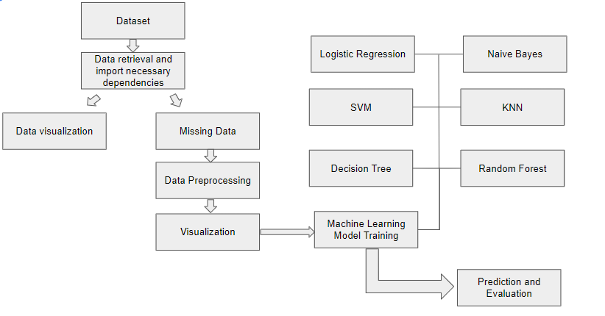
PROPOSED SYSTEM WILL CONSIST OF…

Slide 13
ALGORITHM EXPLANATION
Linear Regression
In statistics, linear regression is a linear approach for modelling the relationship between a scalar response and one or more explanatory variables. The case of one explanatory variable is called simple linear regression; for more than one, the process is called multiple linear regression.
Random Forest Regression
Random Forest Regression is a supervised learning algorithm that uses ensemble learning method for regression. Ensemble learning method is a technique that combines predictions from multiple machine learning algorithms to make a more accurate prediction than a single model

Slide 14
Logistic Regression
Logistic regression is a statistical analysis method to predict a binary outcome, such as yes or no, based on prior observations of a data set. A logistic regression model predicts a dependent data variable by analyzing the relationship between one or more existing independent variables.
Random Forest Classifier
The random forest is a classification algorithm consisting of many decisions trees. It uses bagging and feature randomness when building each individual tree to try to create an uncorrelated forest of trees whose prediction by committee is more accurate than that of any individual tree.
KNN
K-Nearest Neighbors Algorithm. The k-nearest neighbors algorithm, also known as KNN or k-NN, is a non-parametric, supervised learning classifier, which uses proximity to make classifications or predictions about the grouping of an individual data point.
ANN (Artificial Neural Networks):
Artificial neural network (ANN) is a computational model that consists of several processing elements that receive inputs and deliver outputs based on their predefined activation functions.

Slide 15
REFERENCES
Air Quality Prediction in Smart Cities Using Machine Learning Technologies Based on Sensor Data: A Review -
Ditsuhi Iskandaryan , Francisco Ramos and Sergio Trilles
Institute of New Imaging Technologies (INIT), Universitat Jaume I, Spain
Received: 07 February 2020; Accepted: 25 March 2020; Published: 1 April 2020
INDIAN AIR QUALITY PREDICTION AND ANALYSIS USING MACHINE LEARNING
-Mrs. A. Gnana Soundari MTech, (PhD) Associate Professor Jeppiaar Engineering College
-Mrs. J. Gnana Jeslin M.E, (PhD) Assistant Professor Jeppiaar Engineering College
-Akshaya A.C Student, Jeppiaar Engineering College
Air Quality Prediction: Big Data and Machine Learning Approaches
-Gaganjot Kaur Kang, Jerry Zeyu Gao, Sen Chiao, Shengqiang Lu, and Gang Xie

Slide 16
THANK YOU

